Slide 1
Numbers and Arithmetic
Introduction to Python

Slide 2
Learning Objectives
Understand the importance of using correct data types: string, integer or float
Use the int, float and round functions
Understand how to use assignment statements correctly
Perform arithmetic using the BIDMAS rule
Write a program involving input, calculation and output

Slide 3
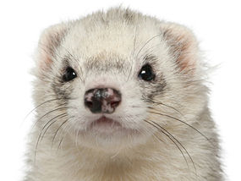
What does this program do?
Look at the code below and describe what each line does
#Animal
animal = input("Enter the name of an animal: ")
description = input("How would you describe a " + animal + "? ")
print ("A",animal,"is",description)
print("You will find it under",animal[0],"in the dictionary")

Slide 4
Data Types
String holds alphanumeric data as text
Integer holds whole numbers
Float holds numbers with a decimal point
Boolean holds either ‘True’ or ‘False’
Currency holds monetary data
Char holds individual characters e.g. “A”
Data/Time e.g. dd/mm/yyyy

Slide 5
Defining Variable Data Types
Python automatically assigns a data type to a variable
You can override this to manually define or change the data type using:
  str() str(animal_name)
  int() int(goals_scored)
  float() float(share_price)
This is called Casting

Slide 6
Choosing Data Types
Data | Example | Data Type | Code
Age | 14 | Integer | int(age)
Shoe Size | 6.5 | Float
Price | 14.99
Postcode
Height
Quantity in Stock
Telephone Number

Slide 7
The Importance of Data Types
Create a variable called mynumber and allow the user to input a value to assign to it
mynumber = input("Enter a number")
print (mynumber + mynumber)
What do you think happens?
Try it!
Convert the data type: mynumber = int(mynumber)
Where would you put this line?

Slide 8
Assignment Statements
Assignment statements assign a value to a variable. If the variable doesn’t already exist, it’s created.
Examples:
name = "Jo" + " Smith"
number = 10
number = input("Enter a number")

Slide 9

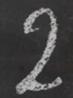
BIDMAS
The order of arithmetic operations matters.
Brackets , Indices, Division and Multiplication, Addition and Subtraction

Slide 10
Arithmetic Operators
Arithmetic | Operator | Example | Output
Addition | + | 2 + 10 | 12
Subtraction | - | 9 – 6 | 3
Multiplication | * | 5 * 4 | 20
Division | / | 5 / 2 | 2.5
Floor Division | // | 7 // 2 | 3
Remainder | % | 7 % 3 | 1

Slide 11
Sleep Calculator
Create a program to calculate how many hours per week you sleep
Try this code and find the problem!
  hourspernight = input("How many hours per night do you sleep? ")
  hoursperweek = hourspernight * 7
  print ("You sleep",hoursperweek,"hours per week")

Slide 12
Sleep Calculator
Add to the problem to find the total number of hours spent sleeping in a month
Assume an average of 4.35 weeks per month
  hourspernight = input("How many hours per night do you sleep? ")
  hoursperweek = int(hourspernight) * 7
  print ("You sleep",hoursperweek,"hours per week")
  hourspermonth = float(hoursperweek) * 4.35
  print ("You sleep",hourspermonth,"hours per month")

Slide 13
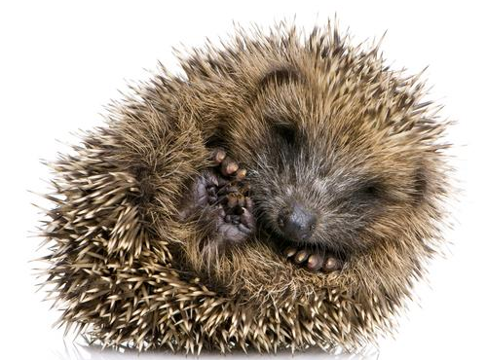
Sleep Calculator
Now find the equivalent number of days per month you sleep for!

Slide 14
Rounding
hourspermonth = 228.37499999999997
round(hourspermonth) = 228
round(hourspermonth,2) = 228.37
  hourspernight = input("How many hours per night do you sleep? ")
  hoursperweek = int(hourspernight) * 7
  hourspermonth = round(hourspermonth)
  print ("You sleep",hoursperweek,"hours per week")
  hourspermonth = float(hoursperweek) * 4.35
  print (“\nYou sleep",hourspermonth,"hours per month")

Slide 15
Finishing off
Display a title for your program when it first runs
Calculate the number of days per year spent asleep
Include the user’s name to make it more user friendly
***** Hello! *****

Slide 16
Calculating Mobile Phone Costs
Create code for an app to do the following:
  Accept the user’s name and mobile phone network
  Ask for the number of minutes they have used this month and multiply that by 0.10 per minute
  Ask for the number of texts that they have sent in a month and multiply that by 0.05 pence per text
  Display a total bill amount for the month
  Displays a new total including VAT of 20%

